Slide 1
Supplier Responses to RFQ – Supplier view

Slide 2
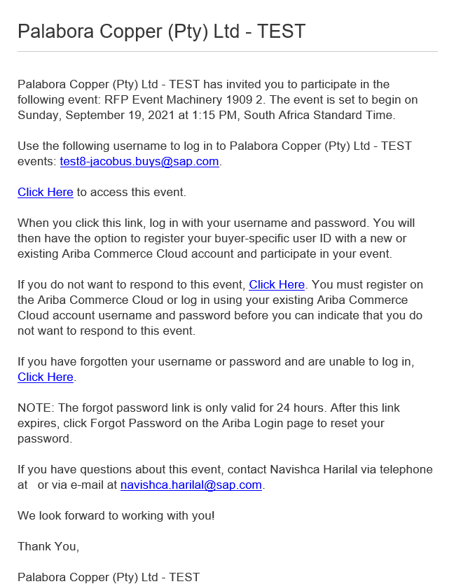
Monitor the RFQ Event
Email to Suppliers
Event is LIVE and suppliers can now respond
Emails will be send to the suppliers informing them of the Event

Slide 3
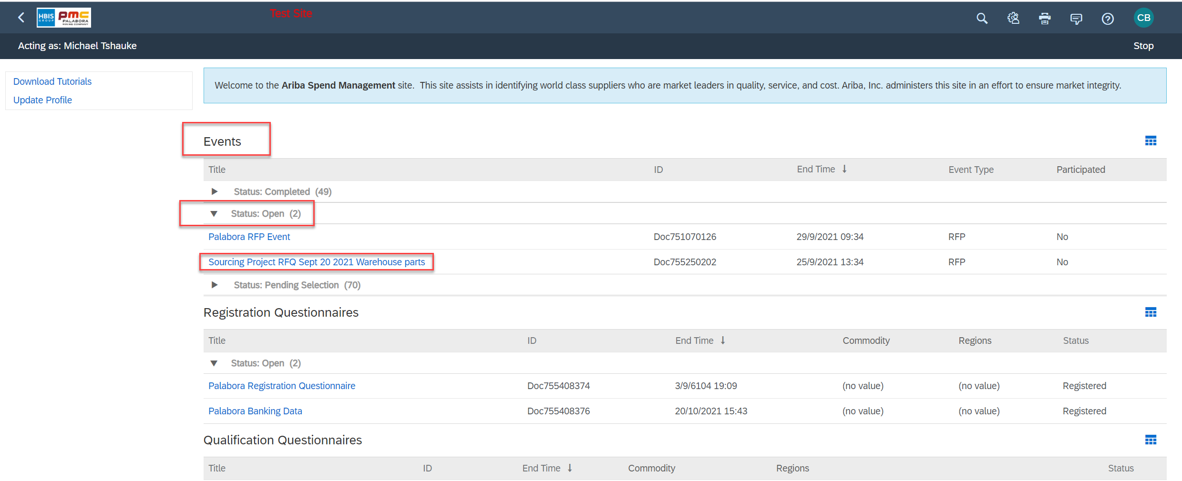
Supplier Responses
Supplier will be directed to the Event by clicking on the email received.
Supplier will log in and find the new RFQ under Open Events

Slide 4
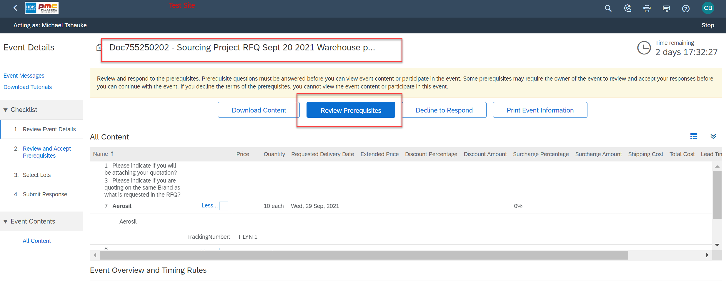
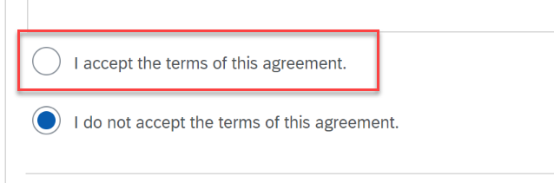
Supplier Responses
Select Review Prerequisites
The Supplier will have to accept the Bidder Agreement before they can participant in this specific event.
Accept the Terms and Agreement

Slide 5
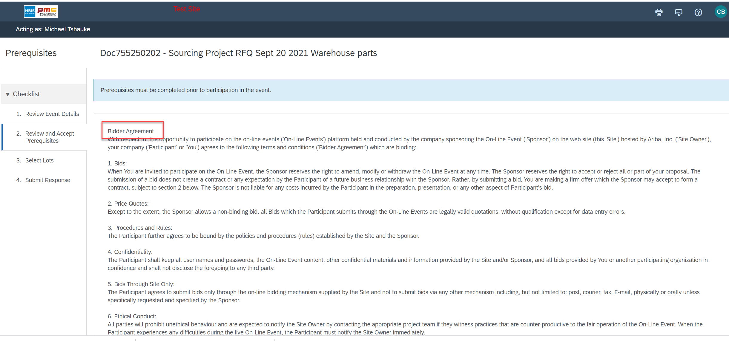
Supplier Responses

Slide 6
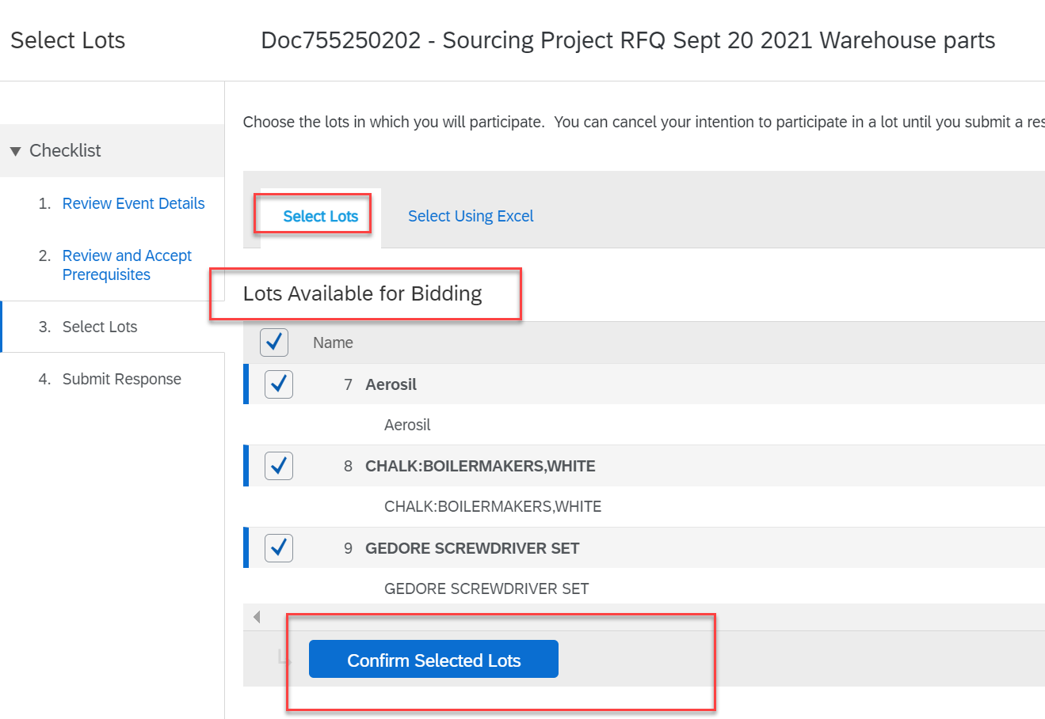
Supplier Responses – Goods select Lots
Select he lots in which the supplier intent to respond to.
And Confirm
A supplier does have the option to select only certain lines to respond to

Slide 7
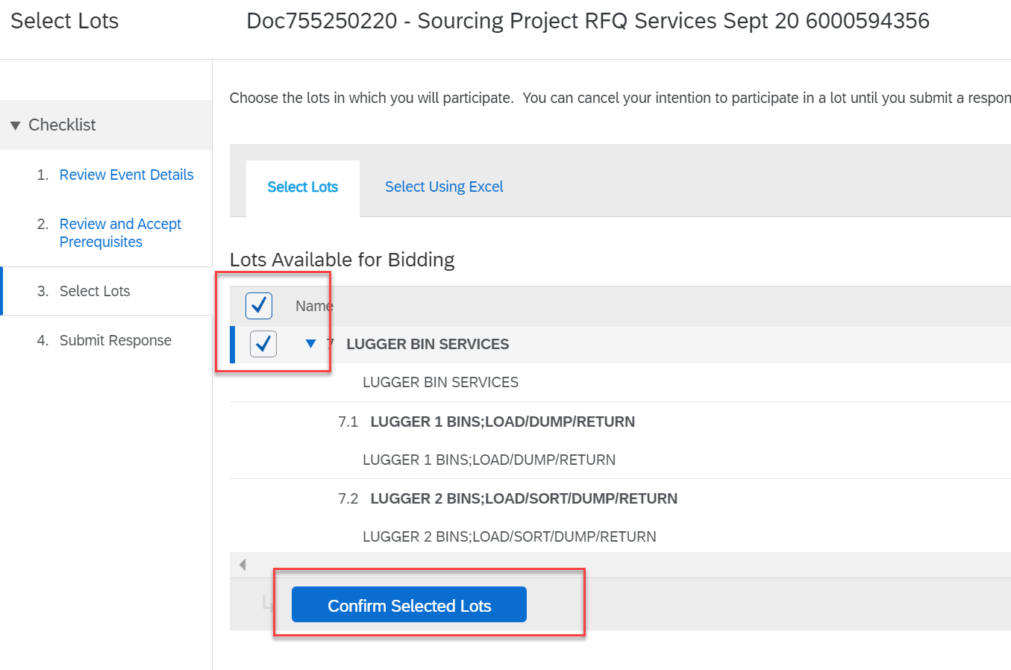
Supplier Responses – Services select Lots
Select he lots in which the supplier intent to respond to.
And Confirm

Slide 8
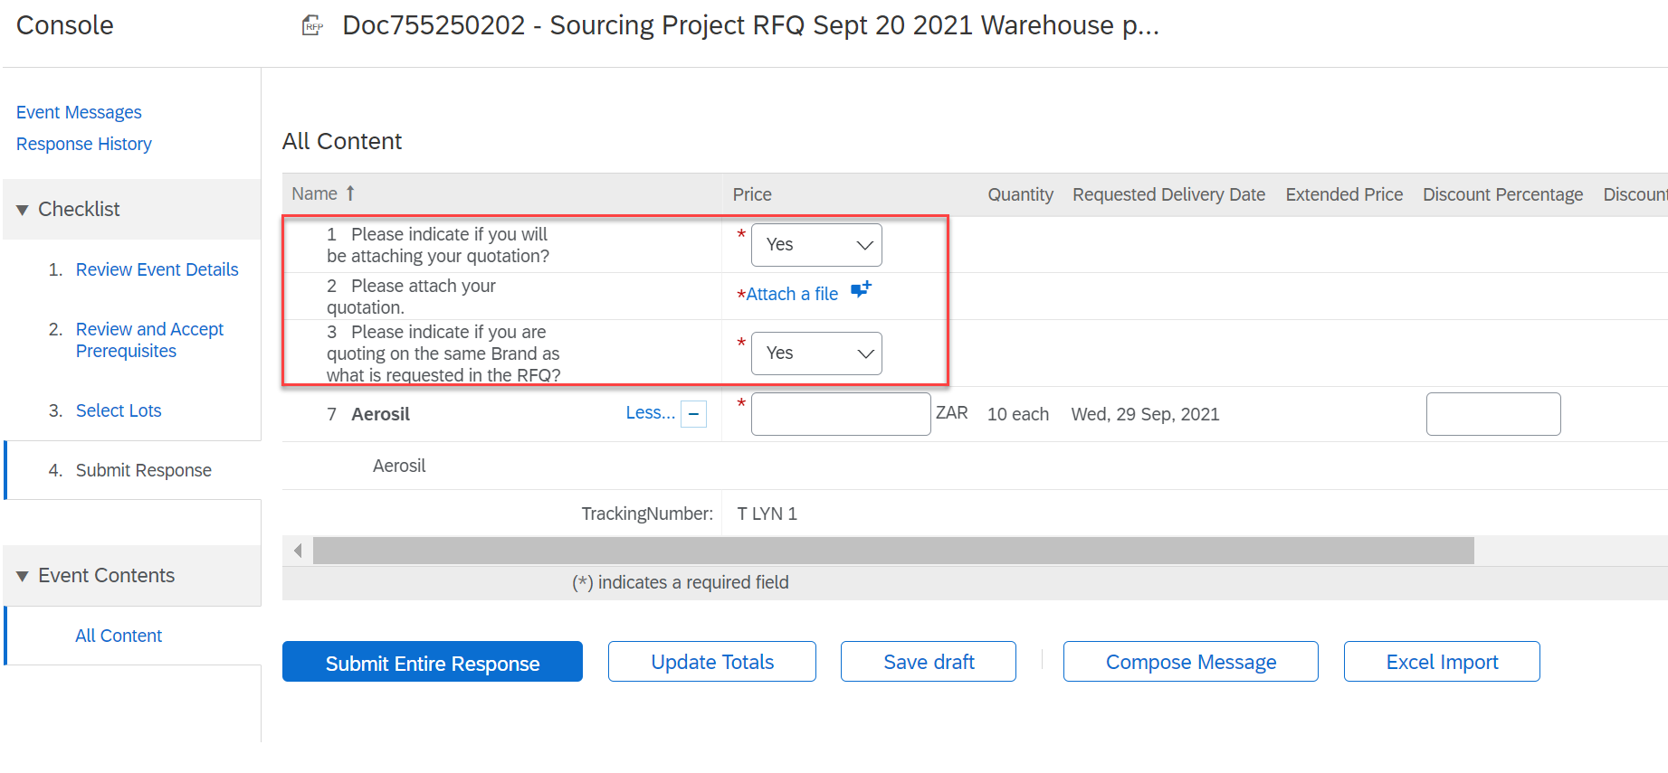
Supplier Responses
The Suppliers have to respond to the first two questions.
If they are going to attach their quotation, then task 2 will open and request them to attach their quote.

Slide 9
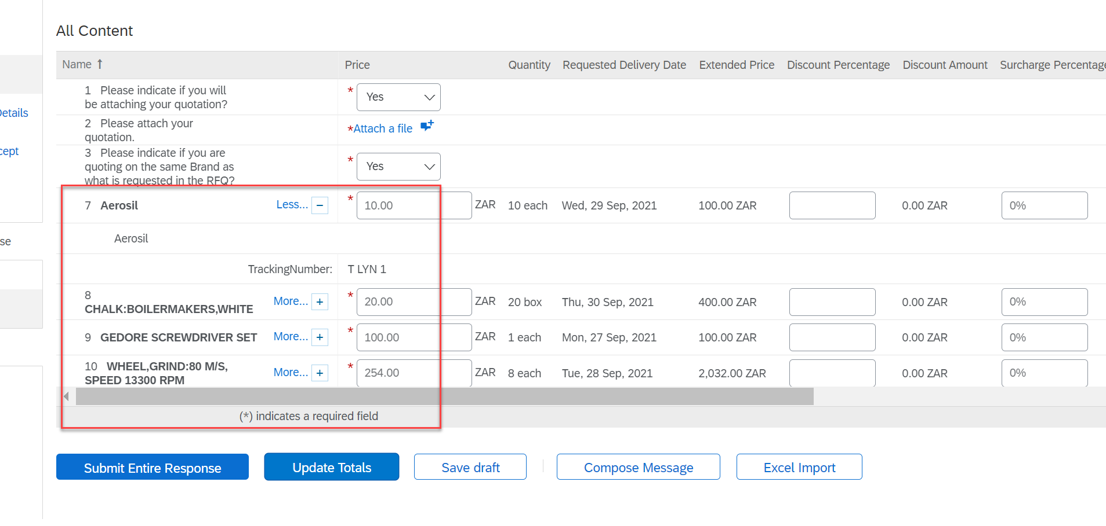
Supplier Responses - Goods
The Suppliers have to respond to the lots they selected to respond to.
Maintain the prices
Submit the response

Slide 10
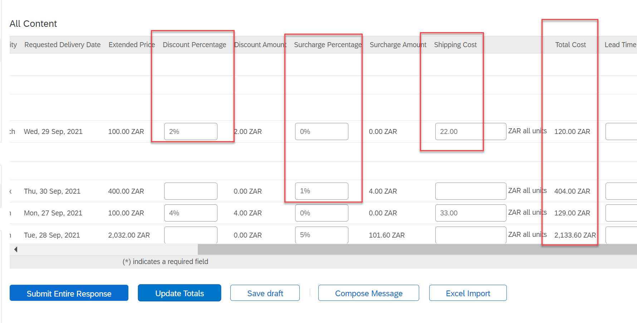
Supplier Responses - Goods
Suppliers may respond with Discounts, Surcharges and Shipping Costs per line.
This will form part of the Total Cost and reflect on the PO when integrated to SAP.
Submit the response

Slide 11
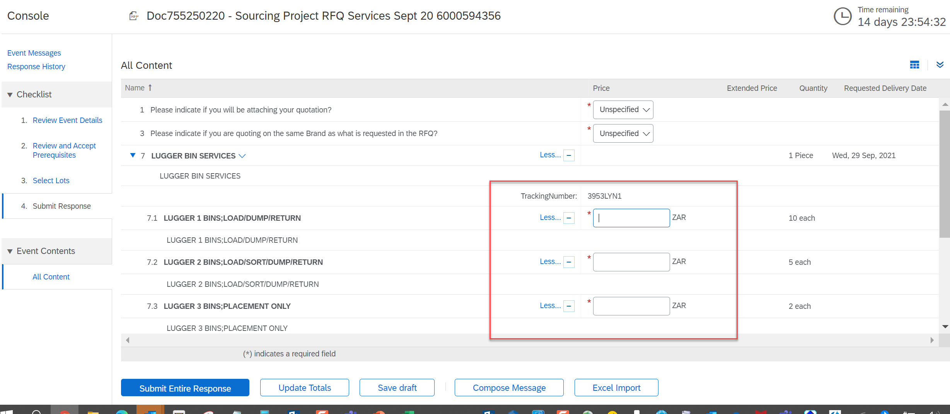
Supplier Responses - Services
Maintain the prices

Slide 12
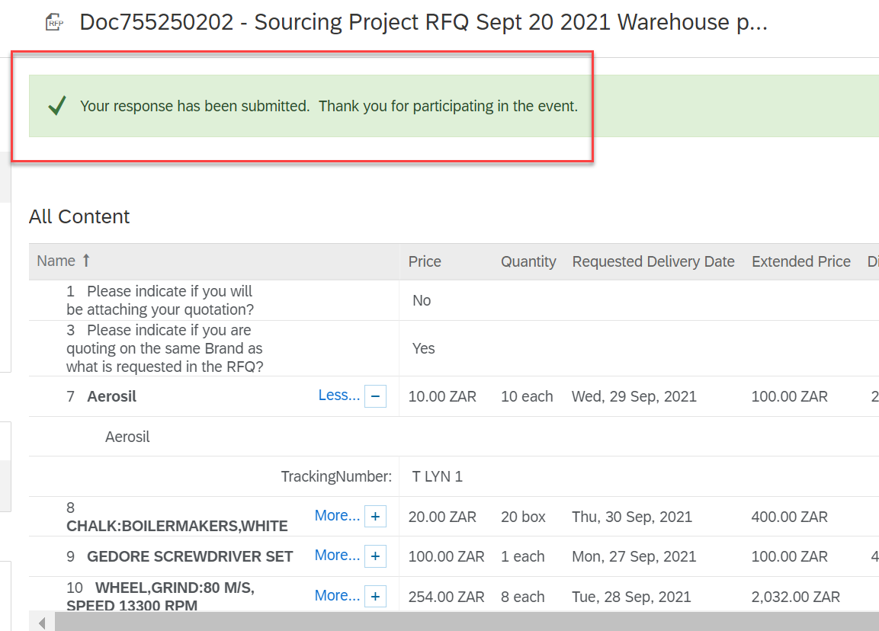
Supplier Responses – Goods

